Slide 1
Chapter 10

Slide 2
Objectives

Slide 3
Objectives (cont.)

Slide 4
Objectives (cont.)

Slide 5
The directories and files for an application that uses packages

Slide 6
The LineItem class

Slide 7
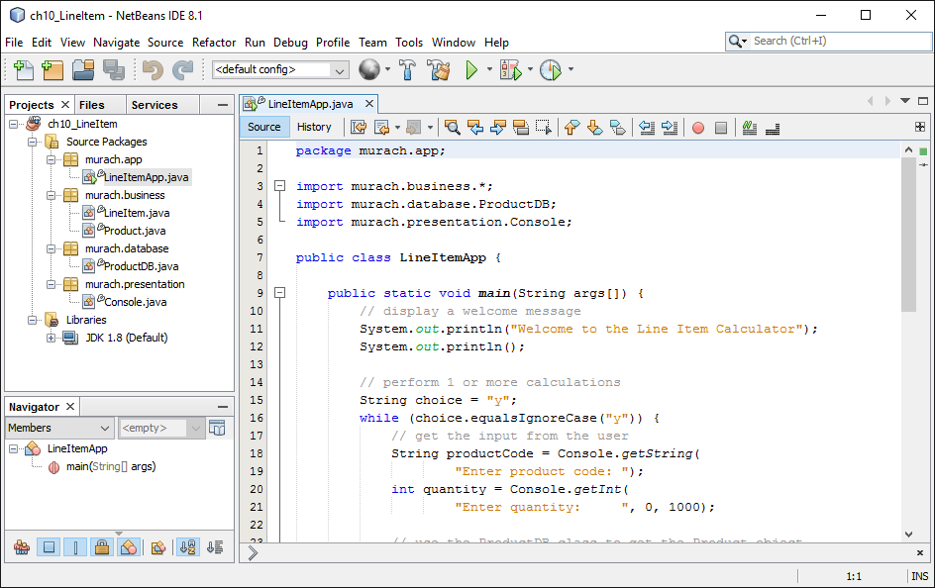
A NetBeans project with multiple packages

Slide 8
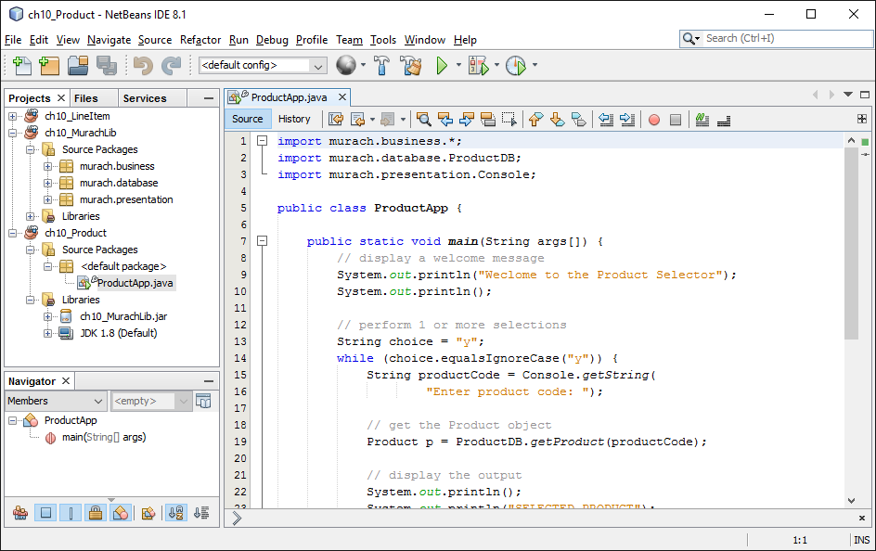
A NetBeans project that uses a library

Slide 9
How to create a library

Slide 10
A module…

Slide 11
Code that defines the java.base module

Slide 12
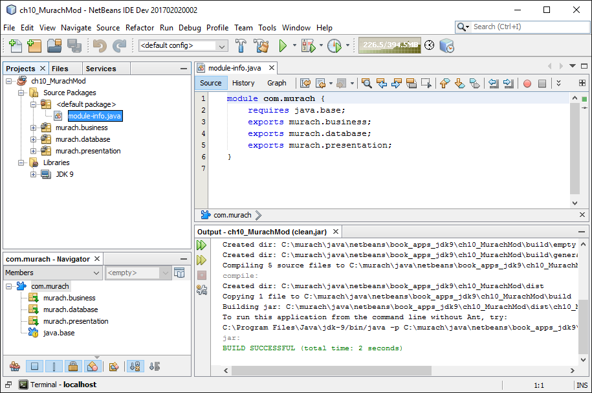
A NetBeans project that defines a module

Slide 13
A module-info file for the com.murach module

Slide 14
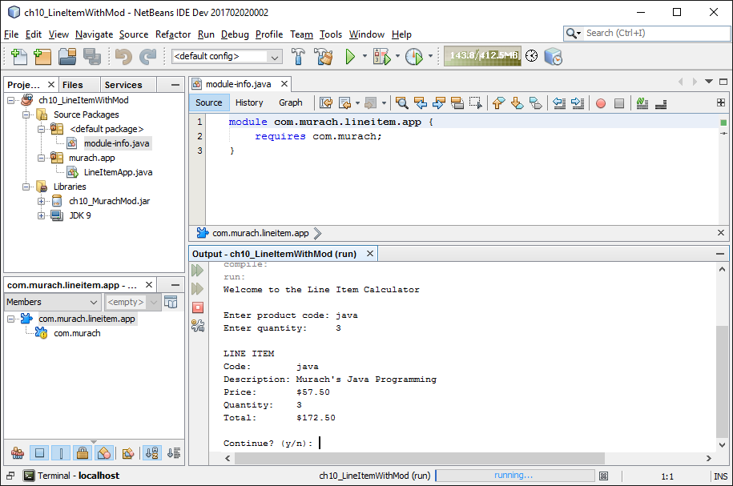
A NetBeans project that uses a module

Slide 15
A module-info file that requires the com.murach module

Slide 16
The Product class with javadoc comments

Slide 17
The Product class with javadoc comments (cont.)

Slide 18
Common HTML tag used to format javadoc comments

Slide 19
The Product class with comments that use HTML and javadoc tags

Slide 20
The Product class with comments that use HTML and javadoc tags (cont.)

Slide 21
The Product class with comments that use HTML and javadoc tags (cont.)

Slide 22
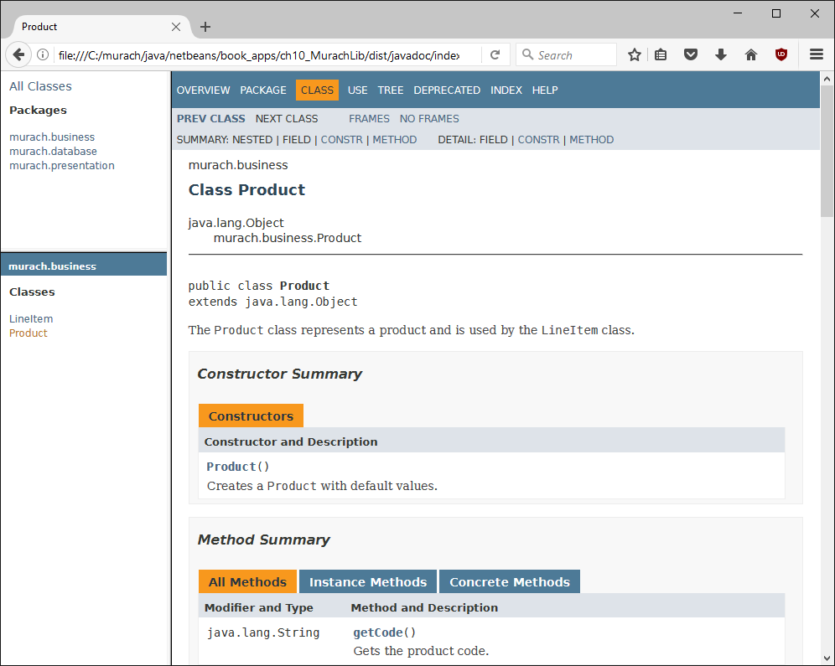
The API documentation for the Product class

Slide 23
The syntax for declaring an enumeration

Slide 24
A method that uses the enumeration as a parameter type

Slide 25
Two methods of an enumeration constant

Slide 26
An enumeration that overrides the toString() method

Slide 27
Code that uses the toString() method

Slide 28
How to code a static import statement

